Slide 1
Advanced Algorithms for THz Sensing and Recognition
Murat Torlak and Yiorgos Makris
March 1st, 2021 Review

Slide 2
Outline
New Scanner Construction
2-D Near-Field SAR Imaging
Simulating the SAR Scenario and Image Recovery
Super-Resolution with Image Enhancing Network
Network Training
Simulation Results
3-D Near-Field SAR Imaging
Simulating the SAR Scenario and Image Recovery
Network Training
Simulation Results
Real-Data Results
Conclusions and Future Work

Slide 3
New Scanner Construction

Slide 4

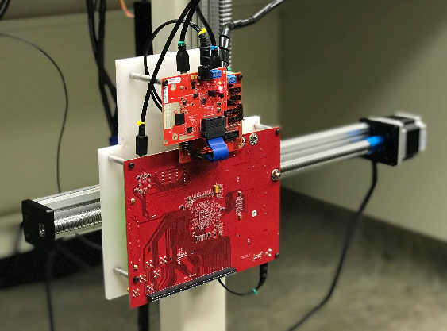
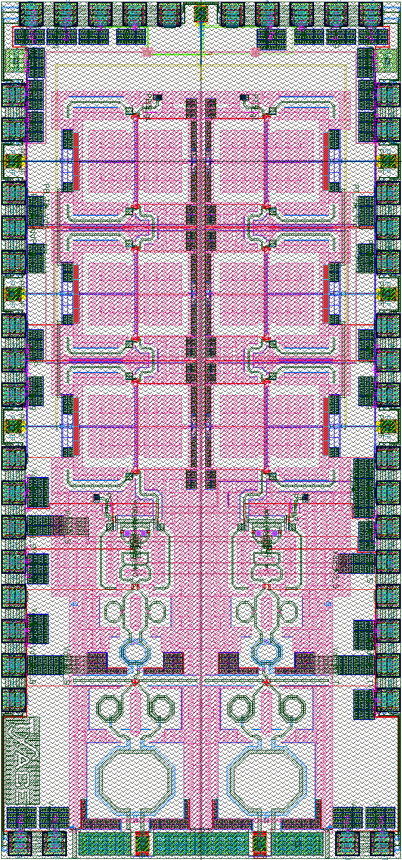

New Scanner Construction
Mail inspection scanner
Requires downward-facing imaging system
Current system is vertically oriented
Working on a new, versatile system
1m

Slide 5
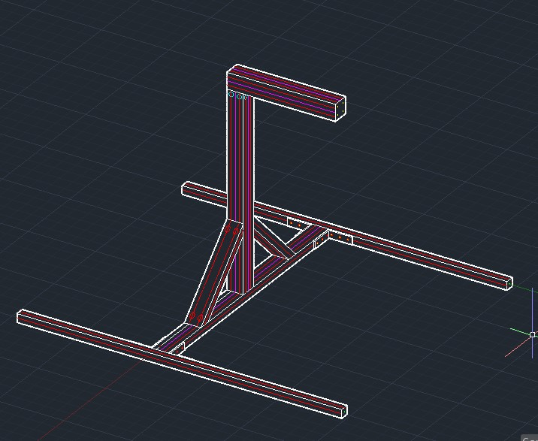
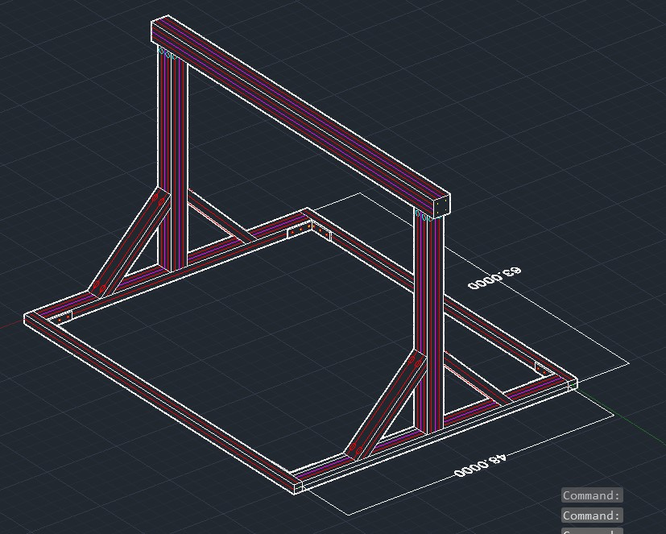
New Scanner Construction

Slide 6
1-D Scanning 2-D Image Reconstruction

Slide 7
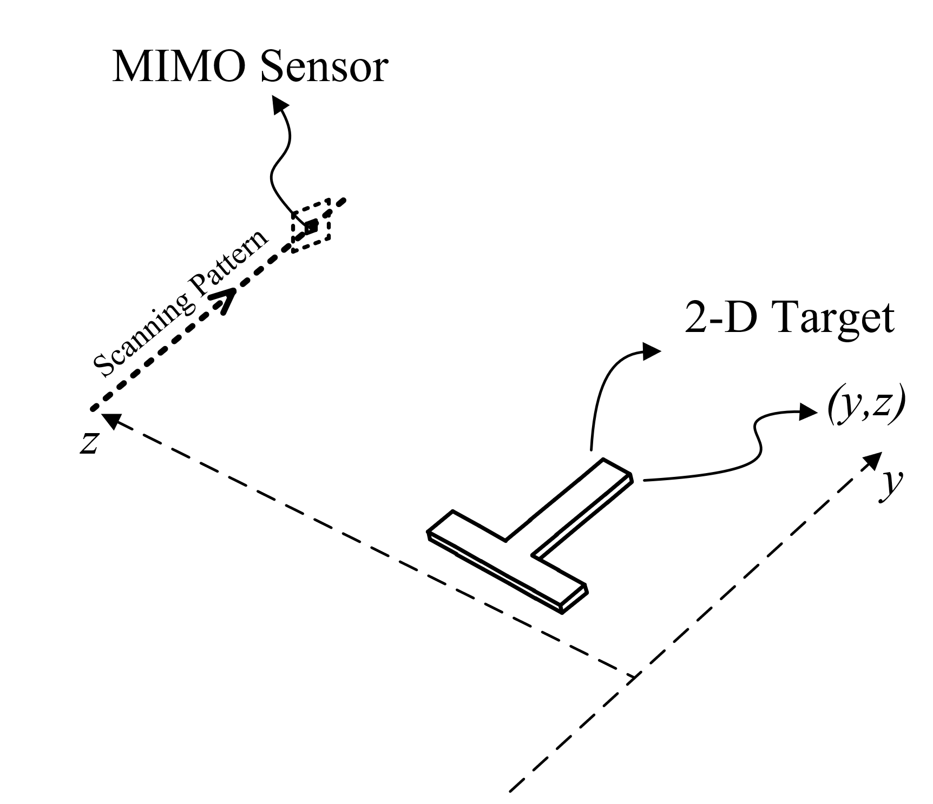
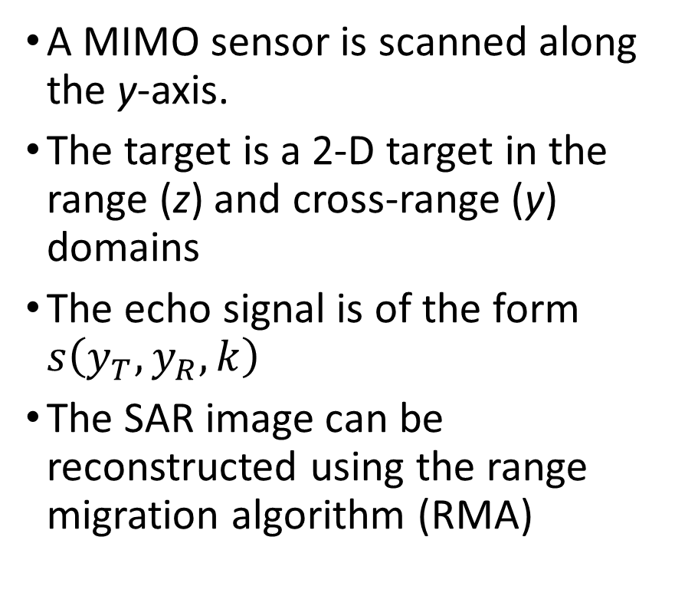
2-D Near-Field SAR Imaging
A MIMO sensor is scanned along the y-axis.
The target is a 2-D target in the range (z) and cross-range (y) domains
The echo signal is of the form $s\left(y_{T},y_{R},k\right)$
The SAR image can be reconstructed using the range migration algorithm (RMA)

Slide 8
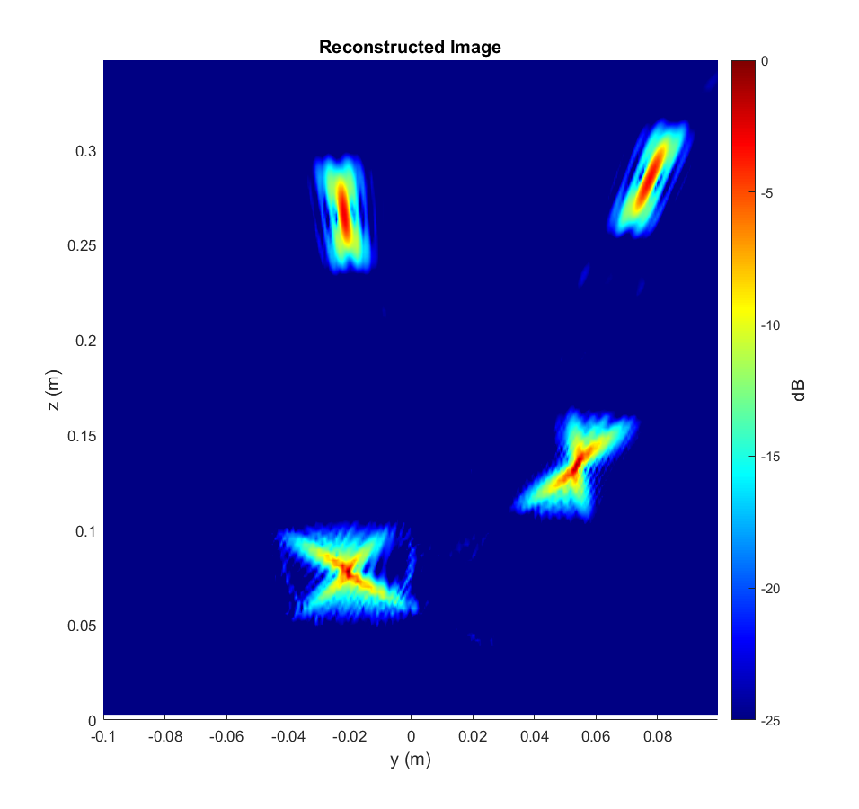
Simulating the SAR Scenario and Image Recovery
Randomly placed point targets
Distortion applied to points is spatially variant
Can we improve the resolution of the recovered image? (“Denoising”)

Slide 9
Super-Resolution with Image Enhancing Network
Improving SAR image resolution has significant effect on numerous applications: detection, classification, item counting, etc.
Goal: reduce distortion from RMA imaging algorithm using a data-driven approach by training using synthetically generated data
Training:
Features: recovered images from RMA using simulated data
Labels: ideal image from simulated data
MIMO Echo Signal
RMA Reconstruction Algorithm
Image Enhancing Network
Better Image!

Slide 10
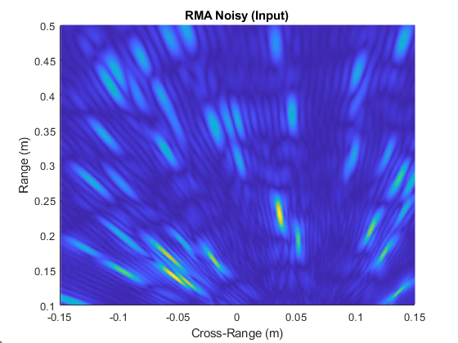
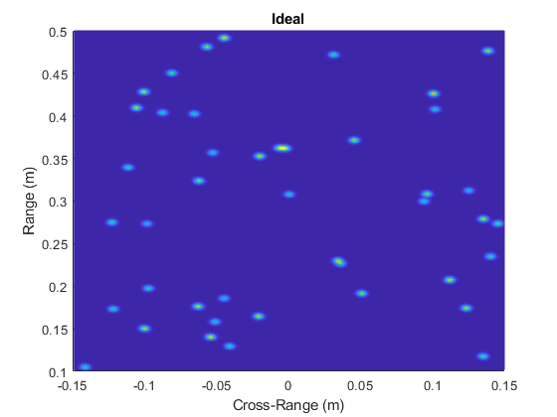
Training Data – Synthetic Data
Training Features:
Image of randomly placed point targets recovered using RMA
Training Labels:
Corresponding ideal image. Each point target treated as narrow 2-D Gaussian pulse

Slide 11
Notes
“Denoising” vs Distortion Removal

Slide 12
Network Training – Image-to-Image Regression
The network will learn to remove the distortion from each RMA image to its corresponding ideal image
In this way, the network learns the distortions introduced by the limited aperture effects, spherical wave approximation, limited bandwidth, path loss, etc.
Features: Distorted Images
Labels: Ideal Images
Image Enhancement Network

Slide 13
Network Architecture
15x15x4 convolution
ReLU Layer
In: 256x256x1
Propose a Fully Convolutional Neural Network Approach
Real-valued 2-D convolution layers, zero-padded to retain image size
Regression layer output
Training Data
65536 simulated samples with real radar noise added
RMA image computed for each sample
Ideal image computed for each sample
40x40x4 convolution
ReLU Layer
15x15x4 convolution
ReLU Layer
3x3x1 convolution
Clipped ReLU Layer
Regression Layer
Out: 256x256x1

Slide 14
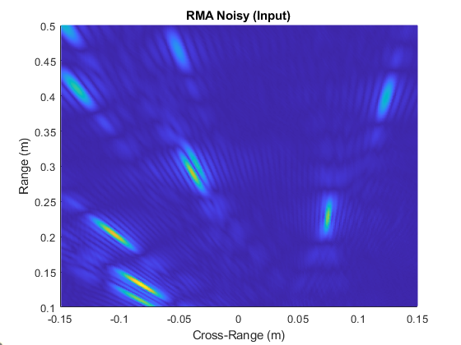
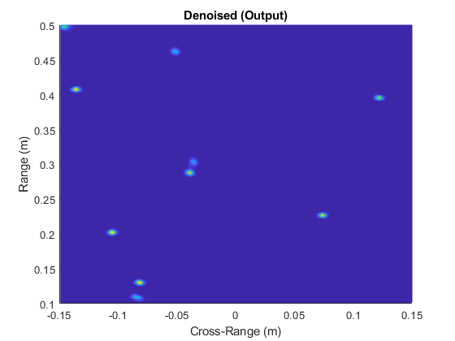
Results – Random Points
Input to Image Enhancement Network
Output
The network has never seen this target before

Slide 15

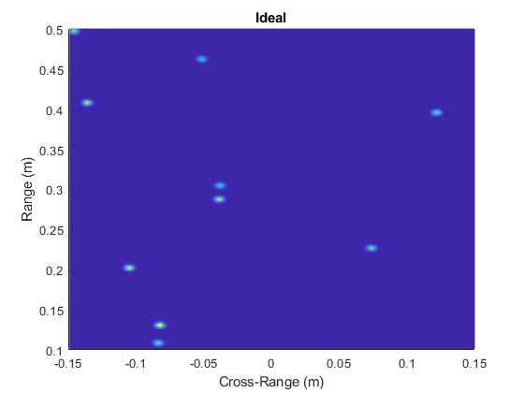
Results – Random Points
Output
Ideal Image – Ground Truth – Label
The network has never seen this target before

Slide 16
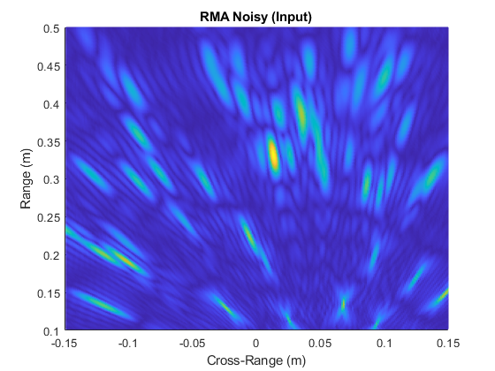
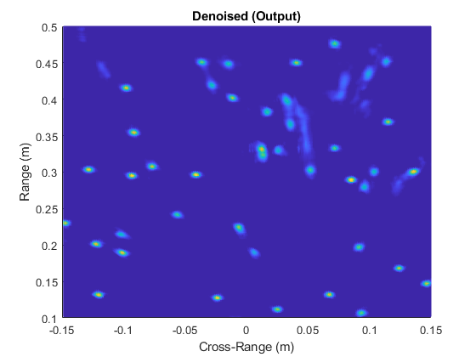
Results – Many Targets
Input to Image Enhancement Network
Output
The network has never seen this target before

Slide 17
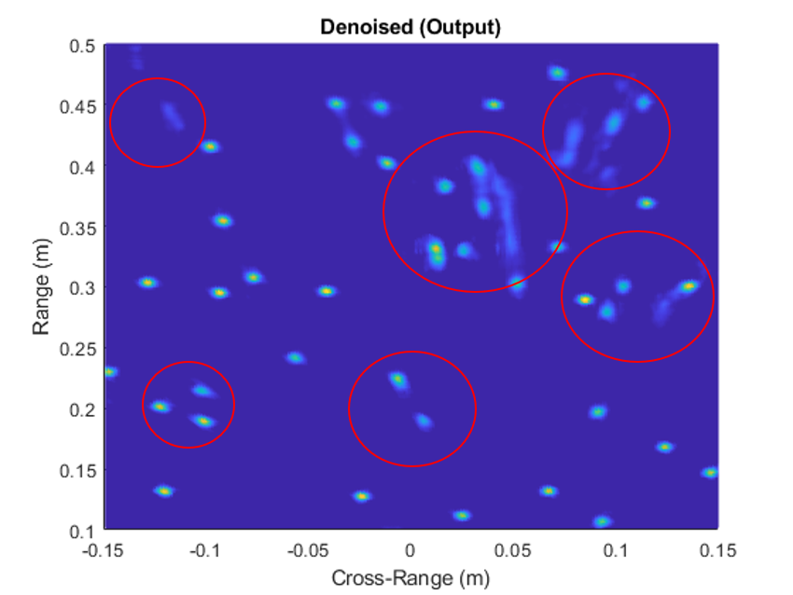
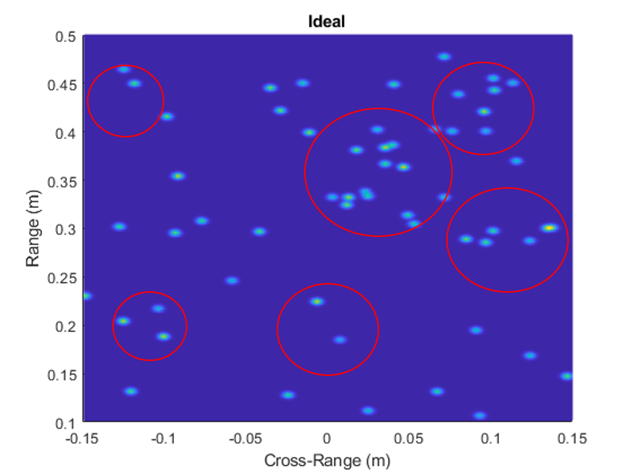
Results – More Targets
Output
Ideal Image – Ground Truth – Label
The network has never seen this target before

Slide 18
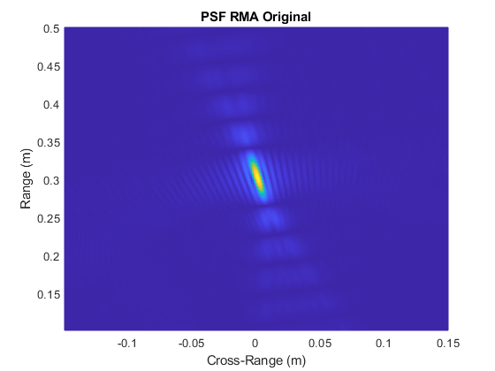
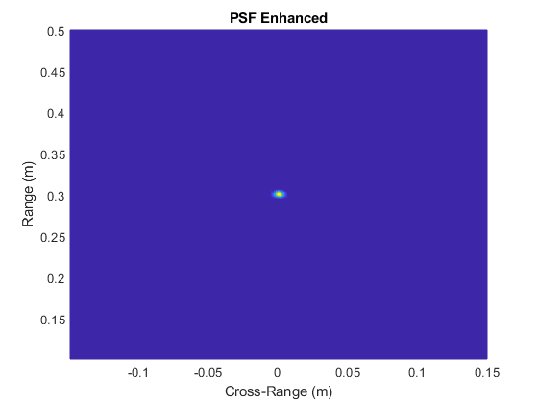
Structured Targets – PSF
Input to Image Enhancement Network
Output
The network has never seen this target before

Slide 19
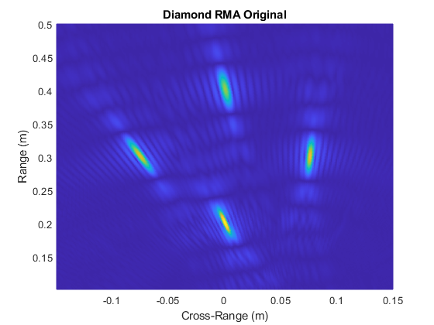
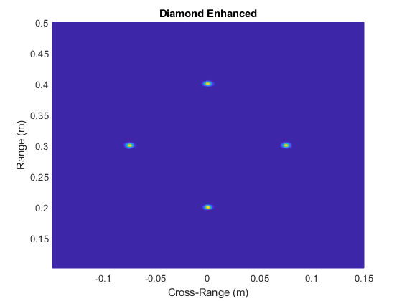
Structured Targets – Diamond
Input to Image Enhancement Network
Output
The network has never seen this target before

Slide 20
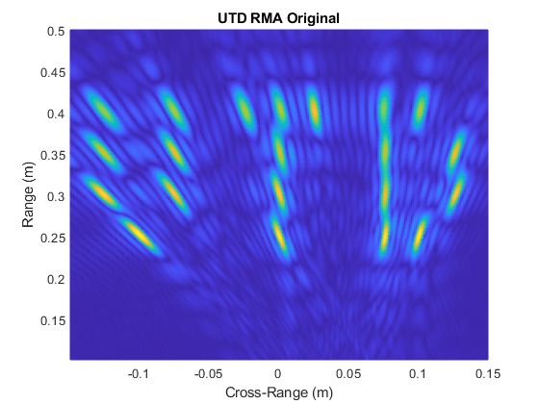
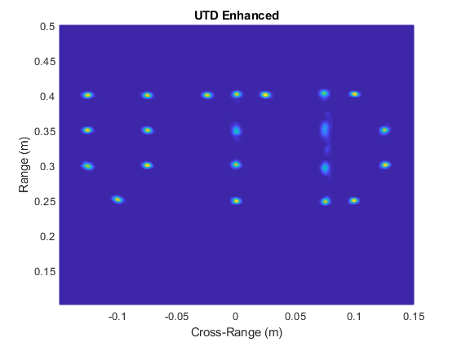
Structured Targets – UTD
Input to Image Enhancement Network
Output
The network has never seen this target before

Slide 21
2-D Scanning 3-D Image Reconstruction

Slide 22
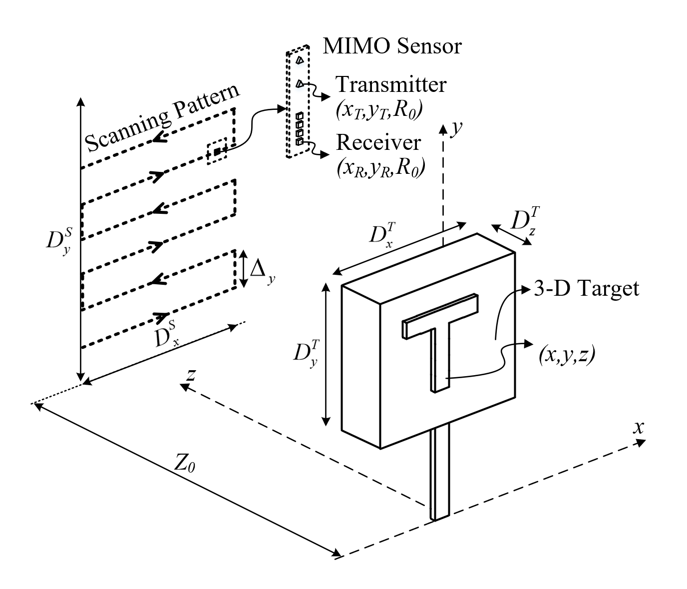
3-D Near-Field SAR Imaging
TI AWR1443 radar using 8 virtual channels simulated
Scanned in planar pattern
3-D target in the near-field
256 x 256 virtual synthetic aperture

Slide 23
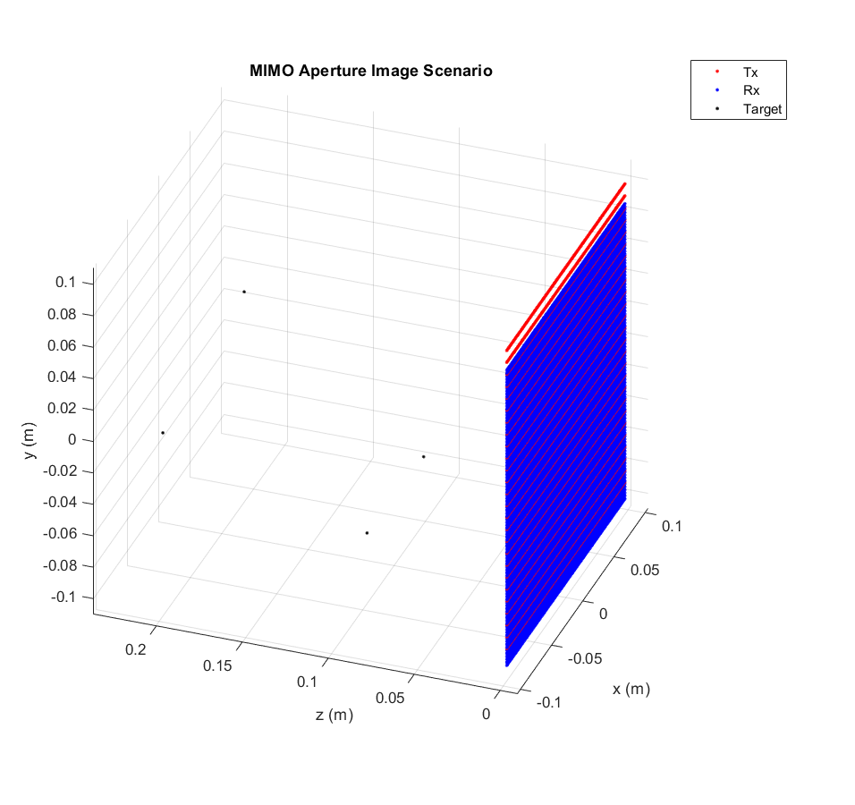
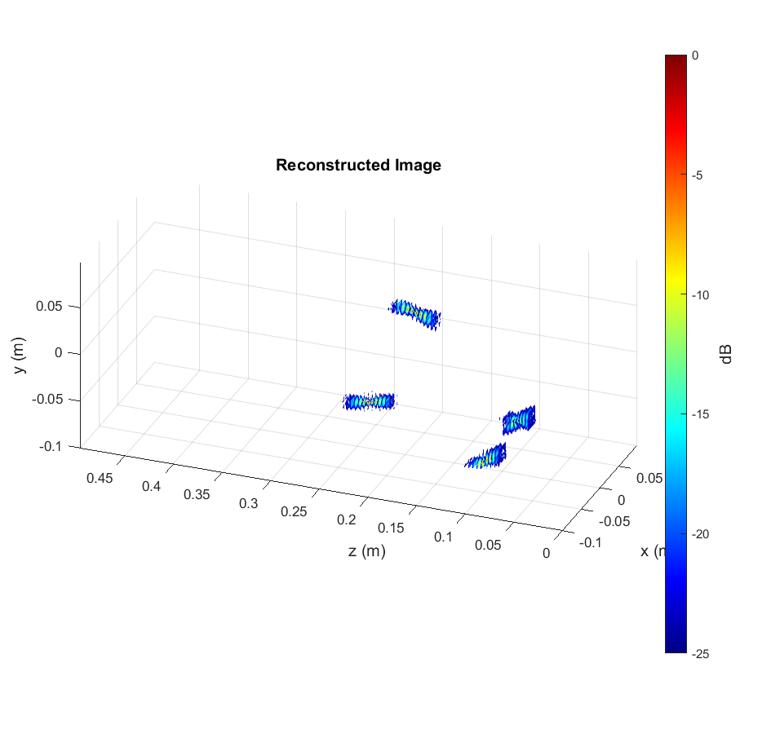
Simulating the SAR Scenario and Image Recovery
Randomly placed point targets
Distortion applied to points is spatially variant

Slide 24
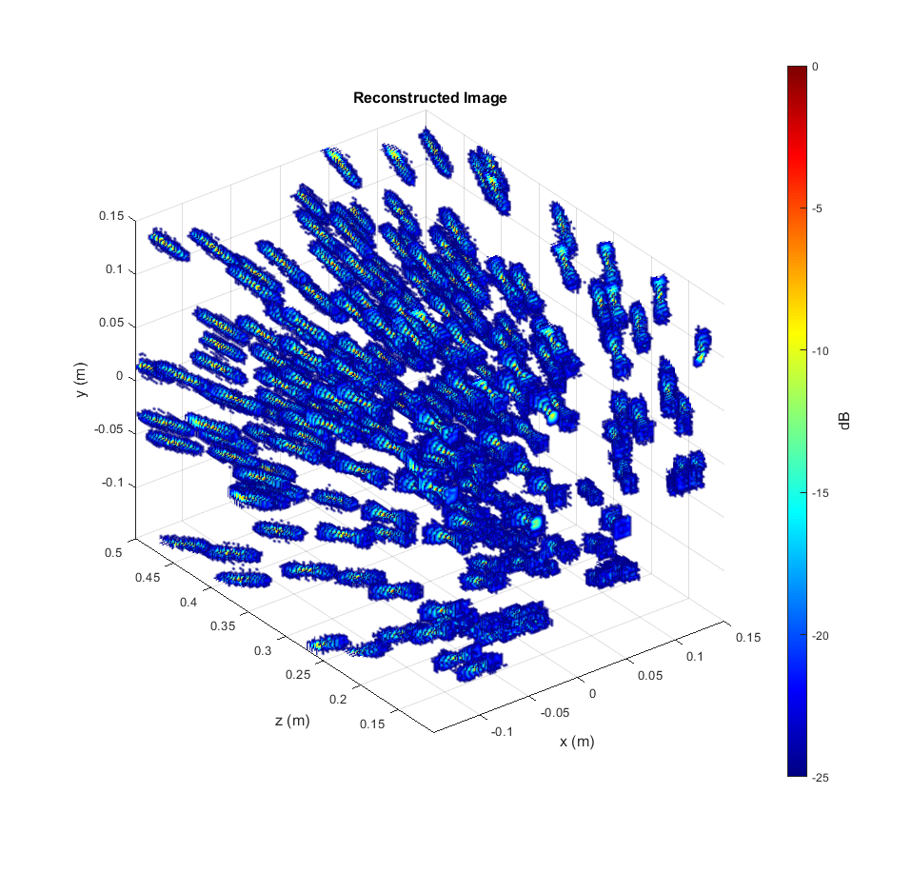
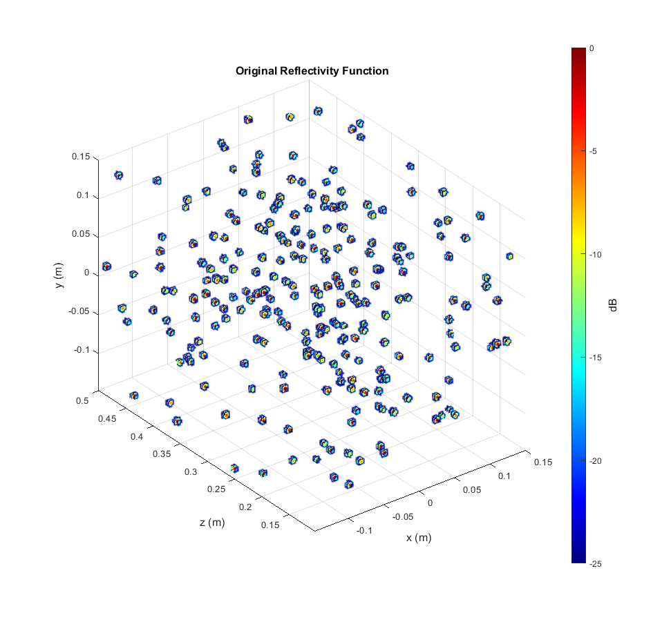
Training Data – Synthetic Data
Training Features:
Image of randomly placed point target recovered using RMA
Training Labels:
Corresponding ideal image. Each point target treated as narrow 3-D Gaussian pulse
Network trained with 1024 samples of size 128x128x128 → Need more computation power

Slide 25
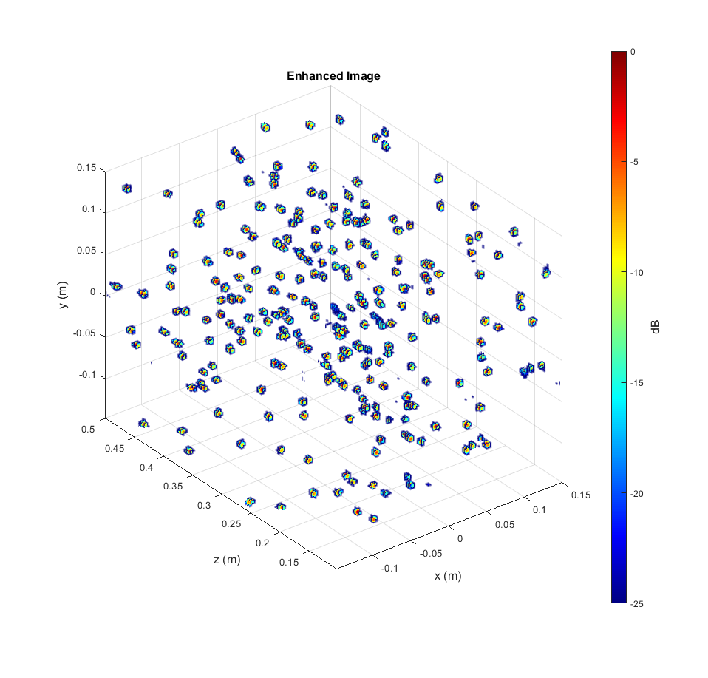
Results – Random Points
Input to Image Enhancement Network
Output
The network has never seen this target before

Slide 26

Results – Random Points
Output
Ideal Image – Ground Truth – Label
The network has never seen this target before

Slide 27
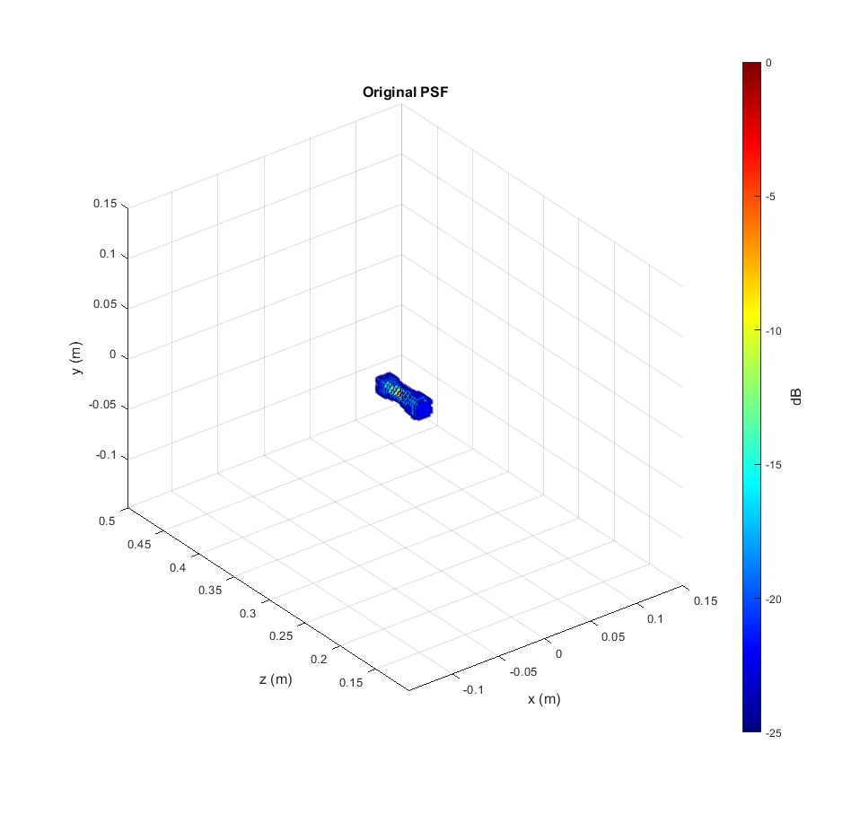
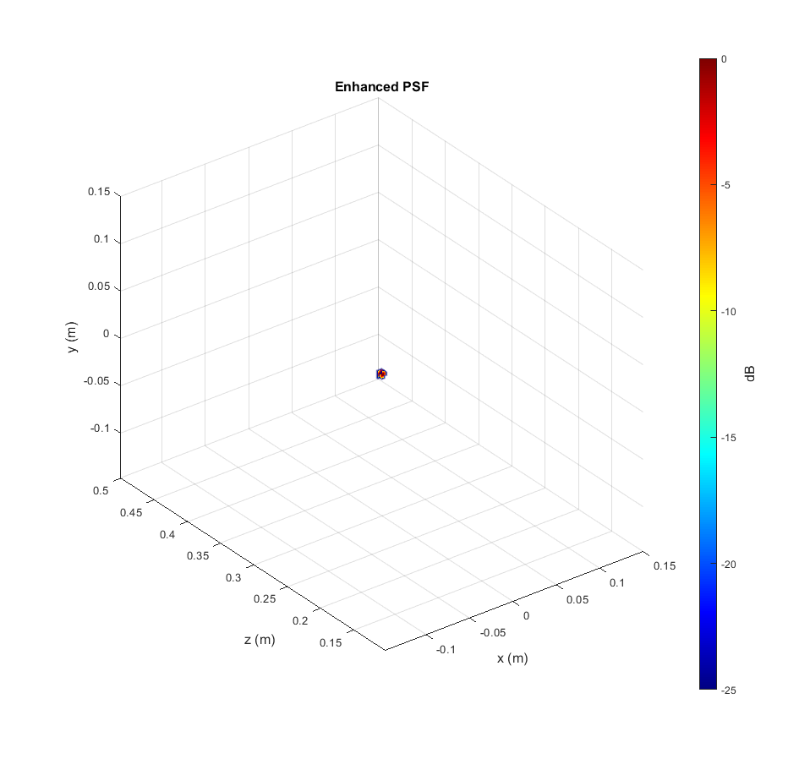
Structured Targets – PSF
Input to Image Enhancement Network
Output
The network has never seen this target before

Slide 28
Structured Targets – PSF Comparison (dB)

Slide 29
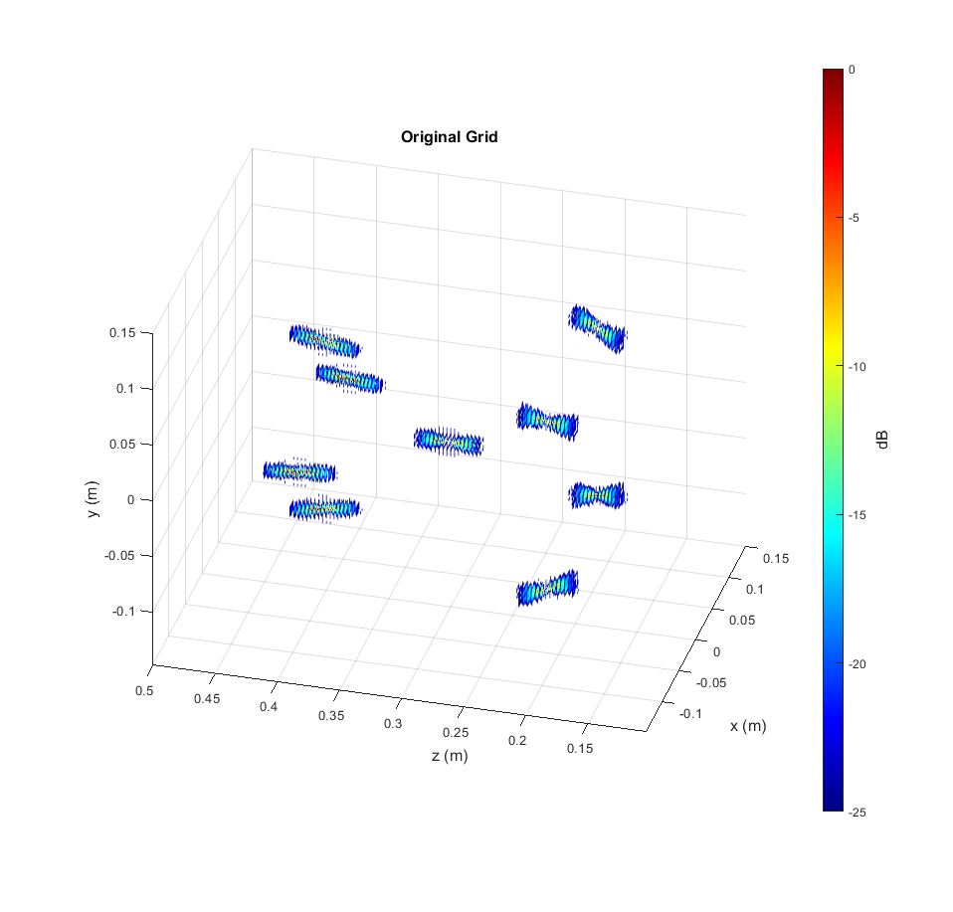
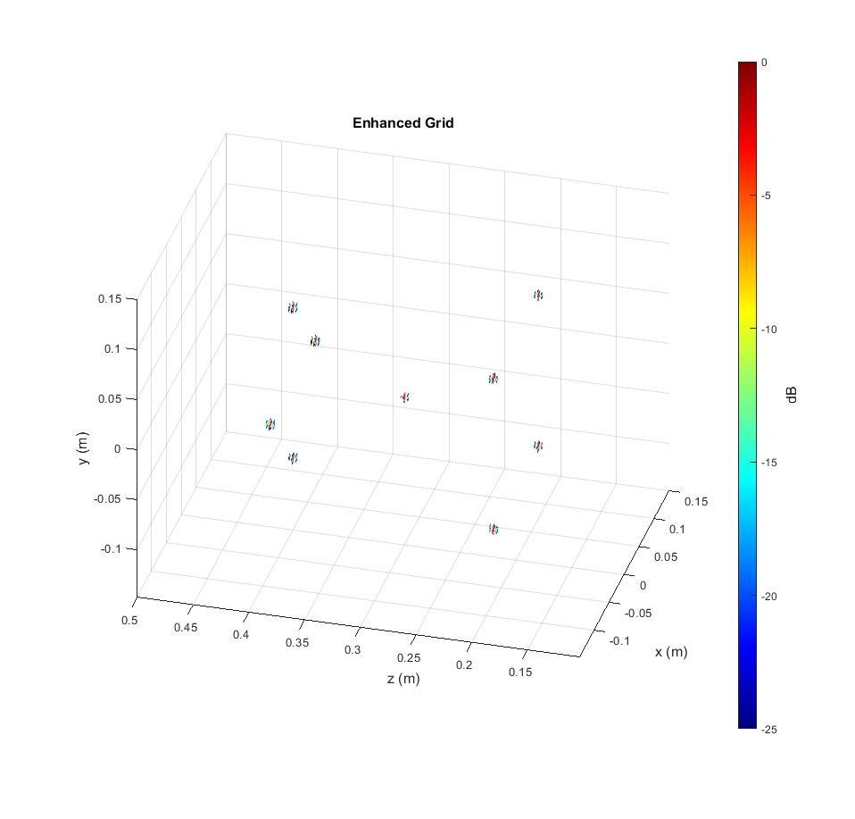
Structured Targets – Grid of Points
Input to Image Enhancement Network
Output
The network has never seen this target before

Slide 30
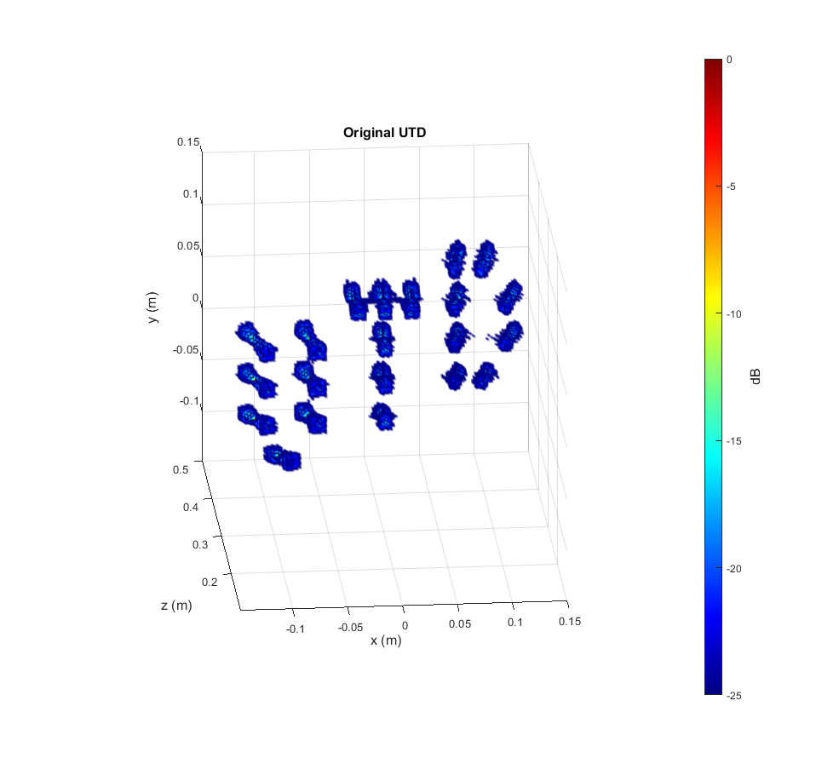
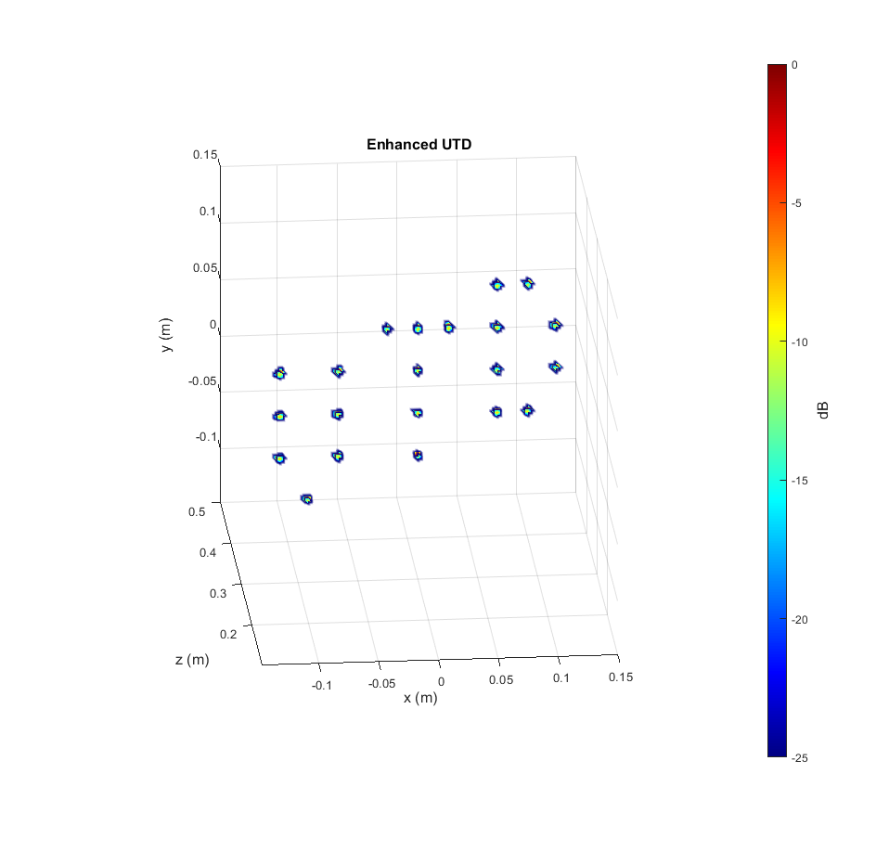
Structured Targets – UTD
Input to Image Enhancement Network
Output
The network has never seen this target before

Slide 31
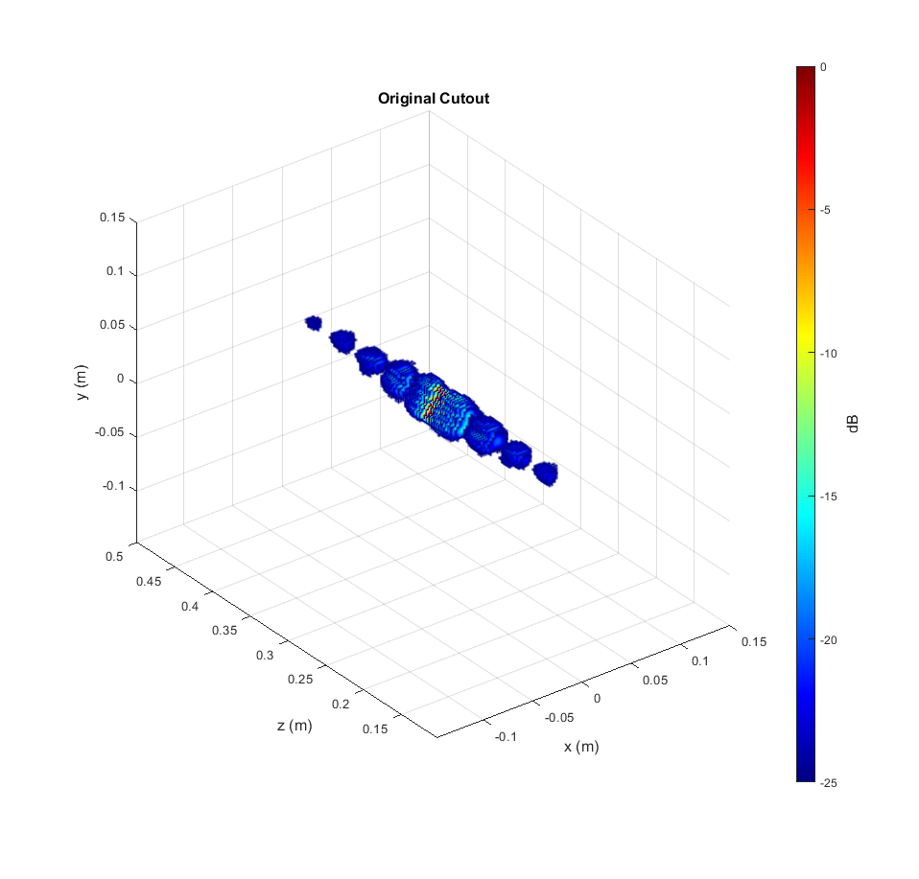
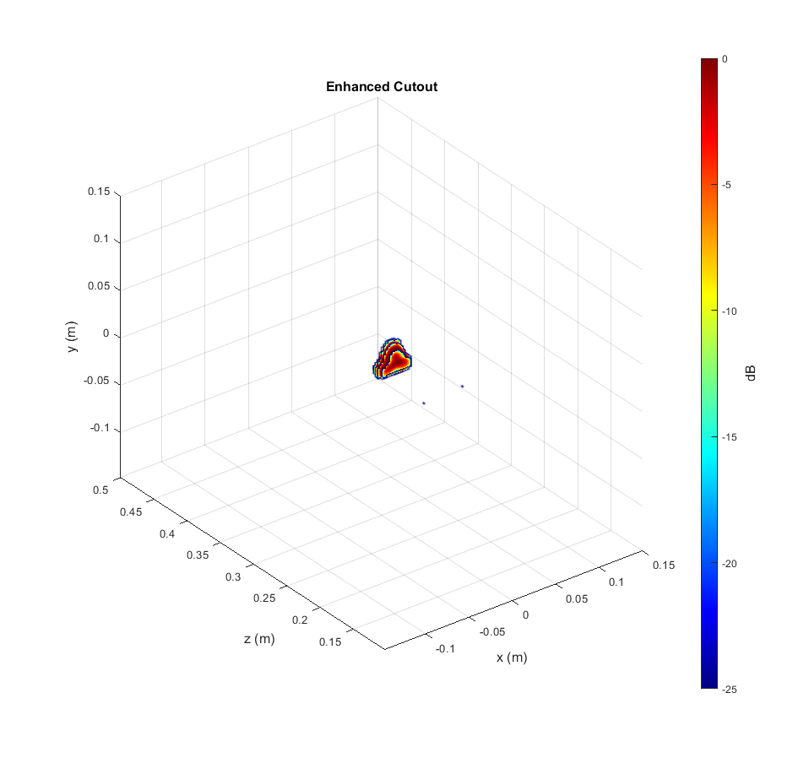
Structured Targets – Triangle
Input to Image Enhancement Network
Output
The network has never seen this target before

Slide 32
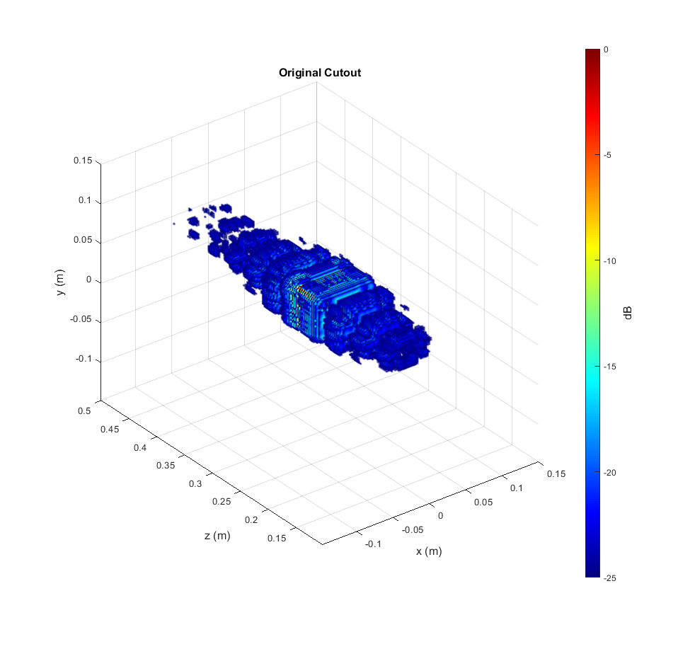
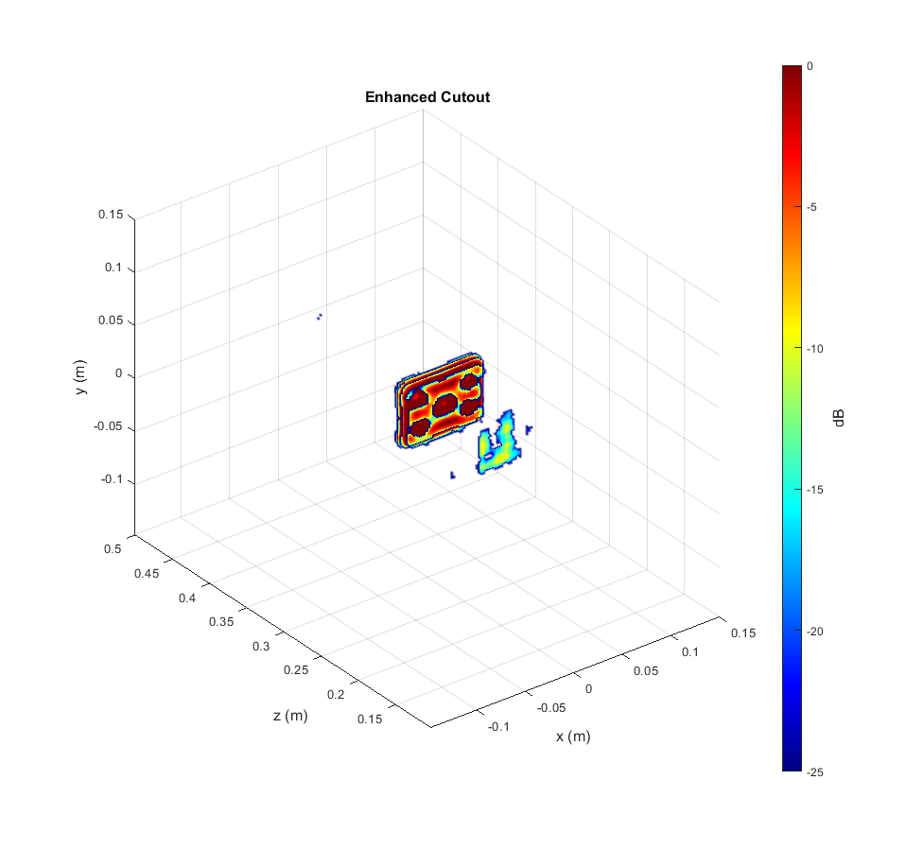

Structured Targets – Cutout
Input to Image Enhancement Network
Output
The network has never seen this target before

Slide 33

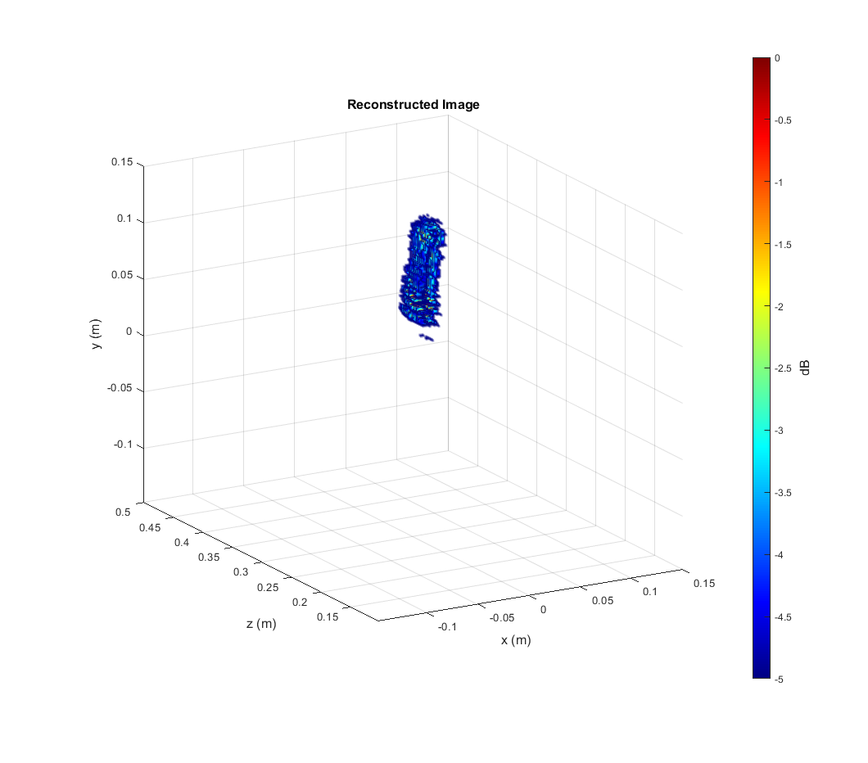

Real-Data Results – Knife
Reconstructed image shows the knife blade (notice dynamic range 5dB)
Knife handle hidden behind structure holding the knife

Slide 34
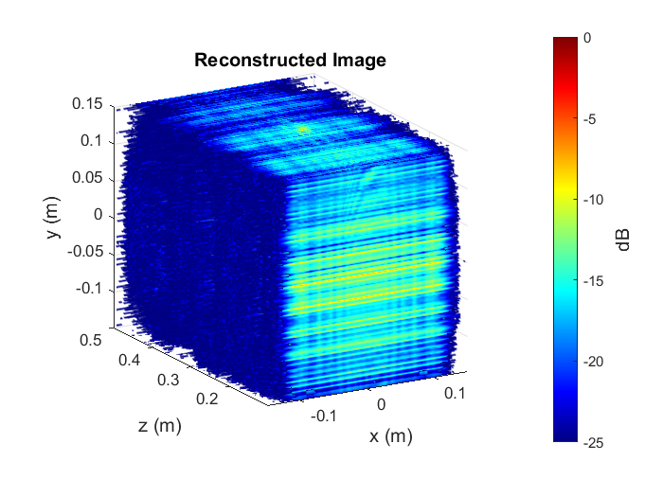
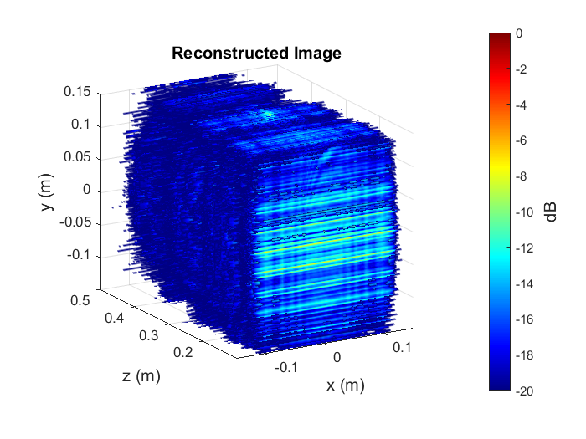
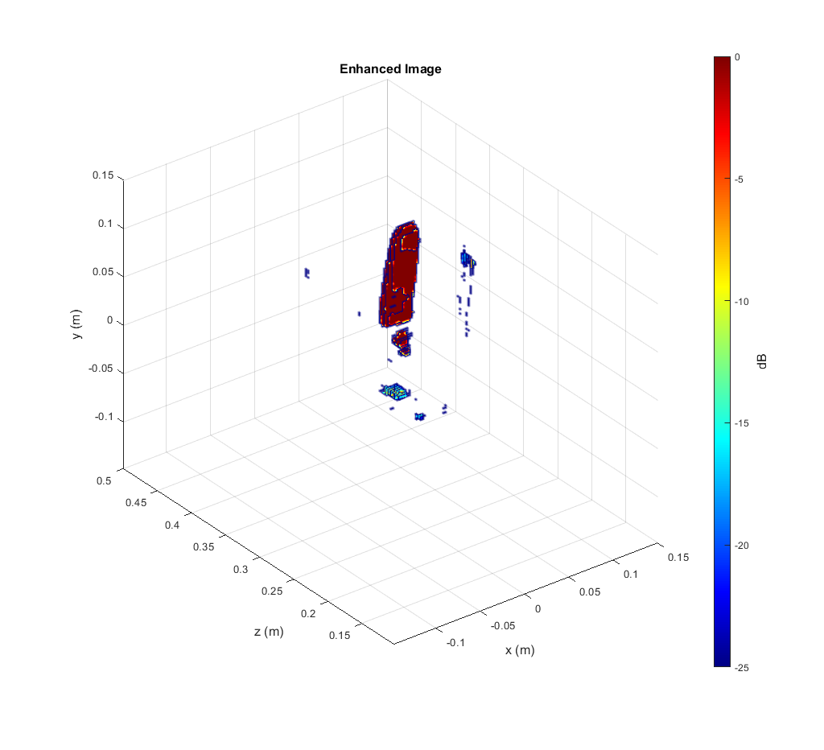
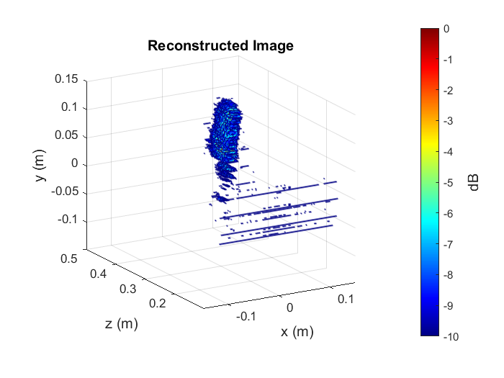
Real-Data Results – Knife
Metal Dots in the handle are now shown (notice dynamic range 25dB)
- Considerable denoising is achieved
25 dB
20 dB
10 dB
5 dB

Slide 35
Conclusions and Future Work
Conclusions
Training on synthetic data does generalize to the real-data case
Near-field SAR super-resolution can be achieved using a data-driven approach, drastically improving the sensing ability of imaging systems for numerous applications
Field is ripe for novelty, innovation, and publication
Future Work
Generate more data – Include shapes, points, 3-D objects, etc.
Optimize network architecture and training
Consider other approaches GANs, sparse CNNs, etc.
Consider various problem statements to improve generalizability
Parameter, scan size/type agnostic network?
Introduce further “realistic errors” into the scanning simulation

